Slide 1
Programming Club
Week 2 – Brute Force(Complete search)
Oct 25th, 2016

Slide 2
Definition
Solving a problem using Brute Force(complete search) is based on the “Keep It Simple, Stupid'' principle. The goal of solving contest problems is to write programs that work in the time allowed, whether or not there is a faster algorithm. (From USACO training page)

Slide 3
Prime number problem
Find all the prime numbers smaller than n.
Input: The single integer n
Output: All the prime numbers smaller than n

Slide 4
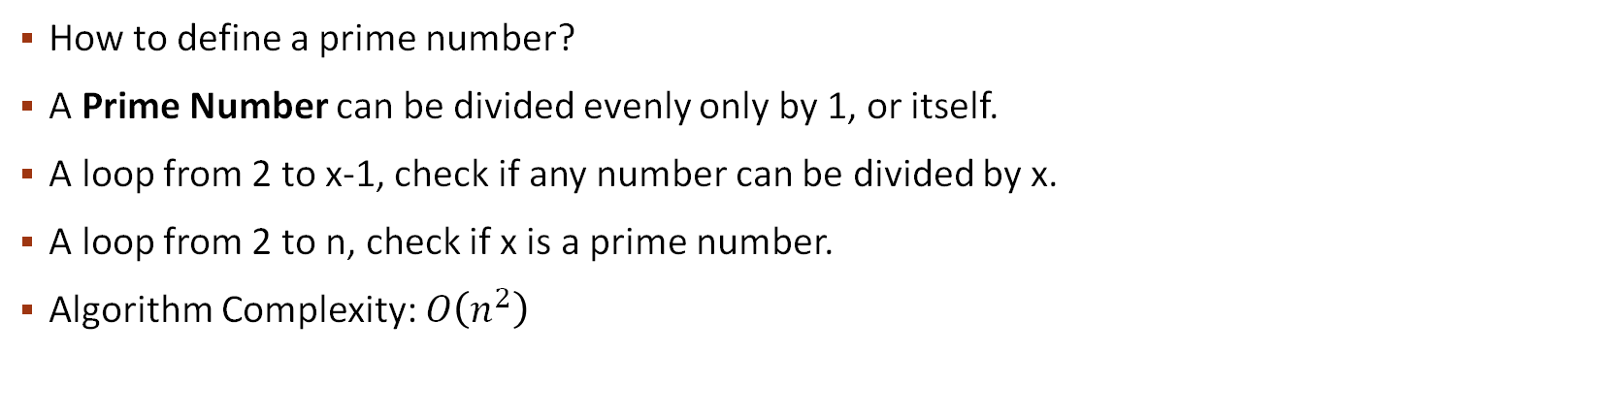
Prime number problem
How to define a prime number?
A Prime Number can be divided evenly only by 1, or itself.
A loop from 2 to x-1, check if any number can be divided by x.
A loop from 2 to n, check if x is a prime number.
Algorithm Complexity: $O\left(n^{2}\right)$
What if n is very large?

Slide 5

Prime number problem
A small reduce:
When check if x is a prime, go from 2 to$\sqrt{x}.$
Algorithm Complexity: $O\left(n\sqrt{n}\right)=O\left(n^{\frac{3}{2}}\right)$.

Slide 6
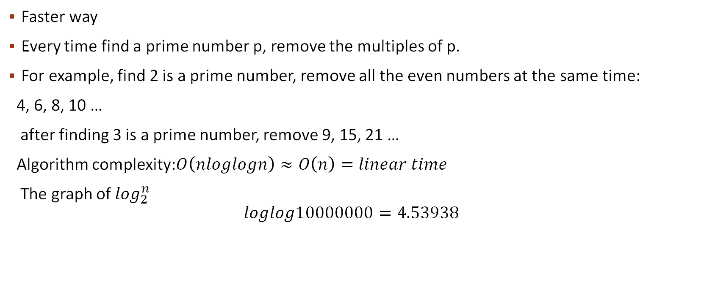
Prime number problem
Faster way
Every time find a prime number p, remove the multiples of p.
For example, find 2 is a prime number, remove all the even numbers at the same time:
4, 6, 8, 10 …
after finding 3 is a prime number, remove 9, 15, 21 …
Algorithm complexity:$O\left(nloglogn\right)≈O\left(n\right)=linear time$
The graph of $\log_{2}^{n}$
$$loglog10000000=4.53938$$

Slide 7
Beru-taxi Codeforces Round #367 (Div. 2)
Vasiliy lives at point (a, b) of the coordinate plane. He is hurrying up to work so he wants to get out of his house as soon as possible. New app suggested n available Beru-taxi nearby. The i-th taxi is located at point (x_{i}, y_{i}) and moves with a speed v_{i}.
Consider that each of n drivers will move directly to Vasiliy and with a maximum possible speed. Compute the minimum time when Vasiliy will get in any of Beru-taxi cars.

Slide 8
Beru-taxi
Input
The first line of the input contains two integers a and b ( - 100 ≤ a, b ≤ 100) — coordinates of Vasiliy's home.
The second line contains a single integer n (1 ≤ n ≤ 1000) — the number of available Beru-taxi cars nearby.
The i-th of the following n lines contains three integers x_{i}, y_{i} and v_{i} ( - 100 ≤ x_{i}, y_{i} ≤ 100, 1 ≤ v_{i} ≤ 100) — the coordinates of the i-th car and its speed.
It's allowed that several cars are located at the same point. Also, cars may be located at exactly the same point where Vasiliy lives.

Slide 9
Beru-taxi
Output
Print a single real value — the minimum time Vasiliy needs to get in any of the Beru-taxi cars. You answer will be considered correct if its absolute or relative error does not exceed 10 ⁻ ⁶.
Namely: let's assume that your answer is a, and the answer of the jury is b. The checker program will consider your answer correct, if .

Slide 10
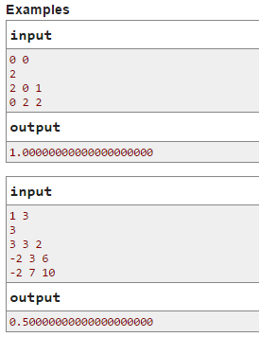
Beru-taxi

Slide 11
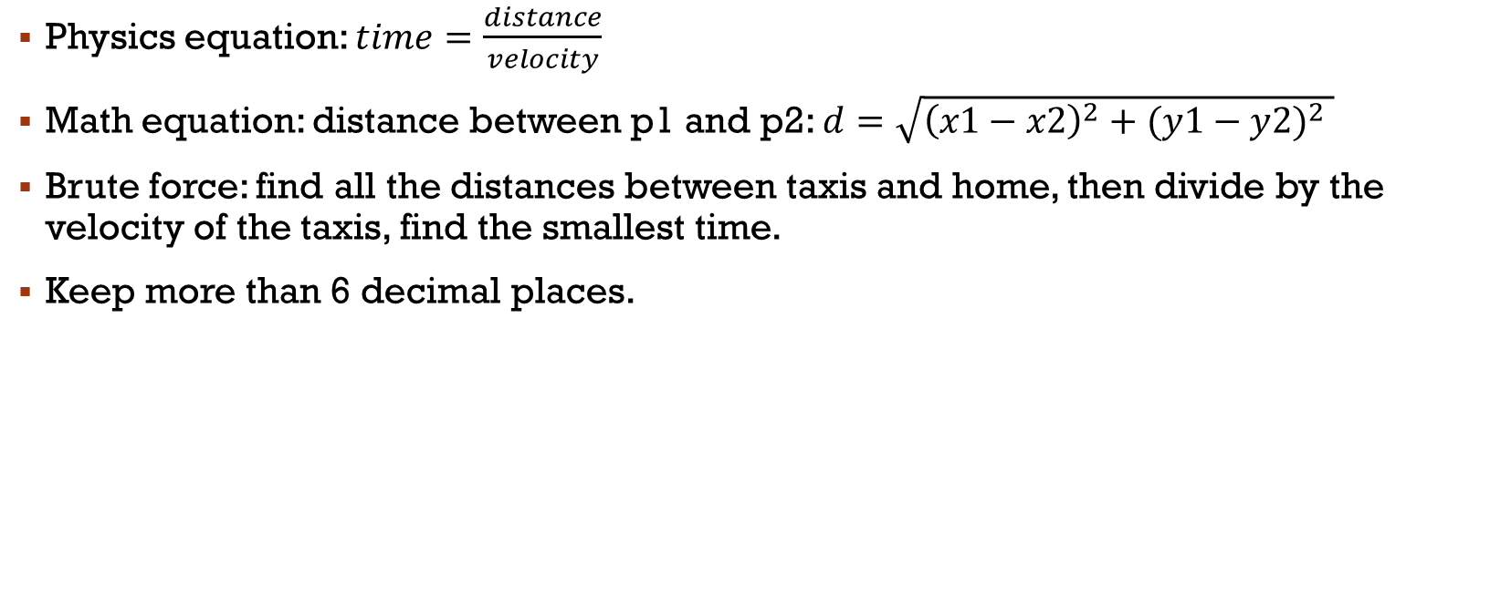
Beru-taxi
Physics equation: $time=\frac{distance}{velocity}$
Math equation: distance between p1 and p2: $d=\sqrt{{\left(x1−x2\right)}^{2}+{(y1−y2)}^{2} }$
Brute force: find all the distances between taxis and home, then divide by the velocity of the taxis, find the smallest time.
Keep more than 6 decimal places.

Slide 12
Appleman and Easy Task Codeforces Round #263 (Div. 2)
Toastman came up with a very easy task. He gives it to Appleman, but Appleman doesn't know how to solve it. Can you help him?
Given a n × n checkerboard. Each cell of the board has either character 'x', or character 'o'. Is it true that each cell of the board has even number of adjacent cells with 'o'? Two cells of the board are adjacent if they share a side.
Input
The first line contains an integer n (1 ≤ n ≤ 100). Then n lines follow containing the description of the checkerboard. Each of them contains n characters (either 'x' or 'o') without spaces.
Output
Print "YES" or "NO" (without the quotes) depending on the answer to the problem.

Slide 13
Appleman and Easy Task
Input:
3
xxo
xox
oxx
Output:
YES
Input:
4
xxxo
xoxo
oxox
xxxx
Output
NO

Slide 14


Appleman and Easy Task
Search each cell of the board $g[i][j] (0≤i, j<n)$
For each cell, check if $g\left[i −1\right]\left[j\right], g\left[i+1\right]\left[j\right], g\left[i\right]\left[j−1\right],g\left[i\right]\left[j+1\right](cells around the cell)$ is ‘O’.
Calculate the number of cells around which is ‘O’ and check if the number is even or odd.
How to check even number and odd number?

Slide 15
Buy a Shovel
Codeforces Round #377 (Div. 2)
Polycarp urgently needs a shovel! He comes to the shop and chooses an appropriate one. The shovel that Policarp chooses is sold for k burles. Assume that there is an unlimited number of such shovels in the shop.
In his pocket Polycarp has an unlimited number of "10-burle coins" and exactly one coin of r burles (1 ≤ r ≤ 9).
What is the minimum number of shovels Polycarp has to buy so that he can pay for the purchase without any change? It is obvious that he can pay for 10 shovels without any change (by paying the requied amount of 10-burle coins and not using the coin of r burles). But perhaps he can buy fewer shovels and pay without any change. Note that Polycarp should buy at least one shovel.

Slide 16
Buy a Shovel
Input
The single line of input contains two integers k and r (1 ≤ k ≤ 1000, 1 ≤ r ≤ 9) — the price of one shovel and the denomination of the coin in Polycarp's pocket that is different from "10-burle coins".
Remember that he has an unlimited number of coins in the denomination of 10, that is, Polycarp has enough money to buy any number of shovels.
Output
Print the required minimum number of shovels Polycarp has to buy so that he can pay for them without any change.
Examples
input
117 3
output
9
input
237 7
output
1
input
15 2
output
2

Slide 17
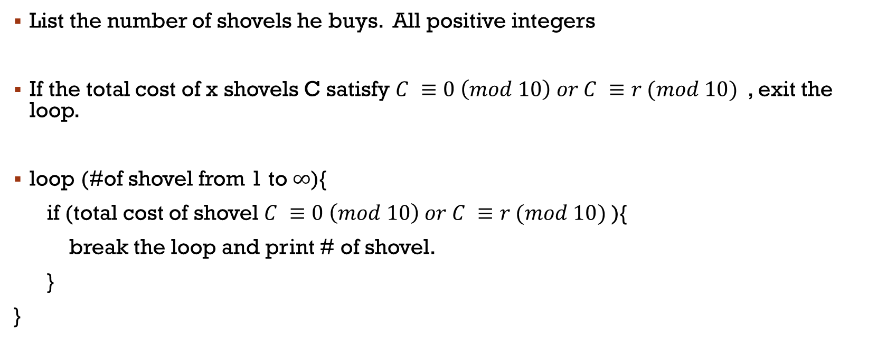
Buy a Shovel
List the number of shovels he buys. All positive integers
If the total cost of x shovels C satisfy $C ≡0 \left(mod 10\right) or C ≡r (mod 10)$, exit the loop.
loop (#of shovel from 1 to $∞$){
if (total cost of shovel $C ≡0 \left(mod 10\right) or C ≡r (mod 10)$){
break the loop and print # of shovel.
}
}

